Slide 1

IBM SkillsBuild for Adult Learners - Data Analytics
Data Analytics Internship Program 2024 Final Project Presentation
Project Name : SDG 14 LBW
Unique ID : IBM2296 Team Name : CodeWin
College Name : Krishna Engineering college, Ghaziabad

Slide 2

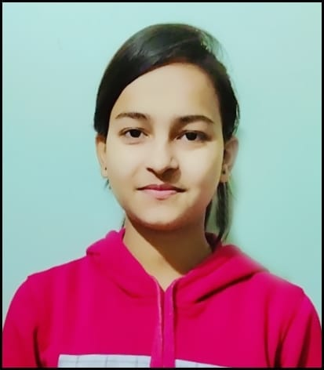
Team Members
Name : Vaibhav Sharma
Email : vaibhav.regkec-28-21@krishnacollege.ac.in
Name : Urvashi
Email : urvashi.regkec-116-21@krishnacollege.ac.in

Slide 3
Introduction
Objective of the Project
The UN has defined 10 targets and 10 indicators for SDG 14 that include preventing and reducing marine
pollution and ocean acidification, protecting marine and coastal ecosystems, and regulating fishing. The targets also call for an increase in scientific knowledge of the oceans. Some targets have a target year of 2020, some have a target year of 2025 and some have no end year.
Overview of the project
Concept of the project
Problem of the statement
Objective of the project
Data source used
Feature of the project
tool for Analysis
hypothesis
methodology
probable outcome
outcome

Slide 4
Problem Identification
The oceans cover more than 70 per cent of the surface of our planet and play a key role in supporting life on earth.
They are the most diverse and important ecosystem, contributing to global and regional elemental cycling, and regulating the climate.
The ocean provides natural resources including food, materials, substances, and energy.
Significance of SDG 14:
Marine Ecosystem Health
Climate Regulation
Economic Benefits
Food Security
Biodiversity
Relevant SDGs
SDG 13 : CLimate Action
SDG 15 : Life on land

Slide 5
Development
Hypothesis
Implementing comprehensive marine conservation policies and sustainable management practices will lead to significant improvements in the health and biodiversity of ocean ecosystems, thereby enhancing their resilience and productivity, which will contribute to economic growth and food security for coastal and marine-dependent communities.
Methodology
Data Collection
Data Cleaning and Preprocessing
Exploratory Data Analysis (EDA)
Source Identification
Predictive Modeling
Reporting and Presentation

Slide 6
Data Collection
Data Tools
Kaggle
UNESCO
UN Environment
Data Description
Various water quality datasets are available on Kaggle, such as the "water Quality classification" and "Water probability".
Datasets from UNESCO science report like research trends by income group.
An policy brief that aggregates water quality data and marine pollution from government and research-grade sources worldwide

Slide 7
Data Analysis
Analytical Tools and Methods Used :These analytical tools and methods are essential for effectively managing marine resources, addressing the challenges posed by pollution and climate change, and ensuring the sustainability of ocean ecosystems. By leveraging advanced technologies, scientific research, and stakeholder engagement, we can better understand and protect the health of our oceans and marine life.
Key Findings : SDG 14 underscores the importance of protecting marine environments and ensuring their sustainable use. While there have been some advances in marine conservation, significant challenges remain, including pollution, overfishing, climate change, and inadequate protection. Addressing these issues requires a multifaceted approach, combining effective policy implementation, scientific research, community engagement, and international cooperation.
Insights Derived : SDG 14 aims to address critical issues affecting the oceans and marine life, highlighting the interconnectedness of environmental health, human well-being, and economic prosperity. Achieving this goal requires a concerted effort across multiple sectors and scales, from local communities to international bodies.

Slide 8
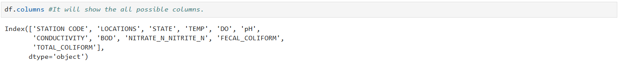
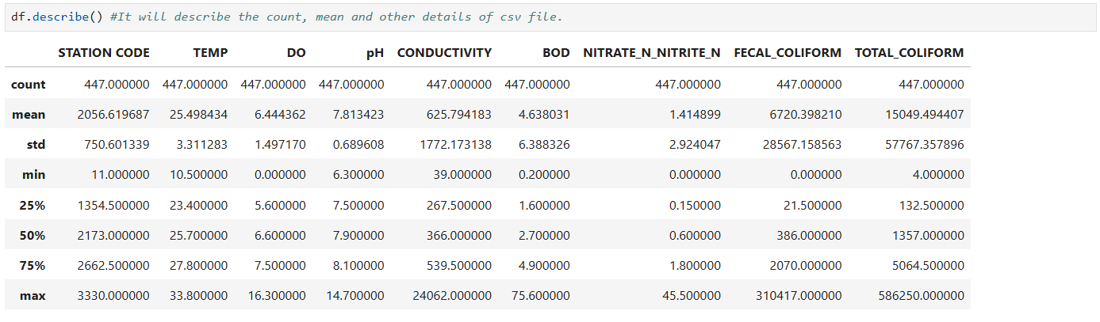
Data Preprocessing
Data Cleaning Methods : Quality Assurance and Documentation , Data Integration and Alignment , Temporal Data Cleaning , Spatial Data Cleaning , Standardization and Formatting , bar charts , scatter charts , etc.

Slide 9
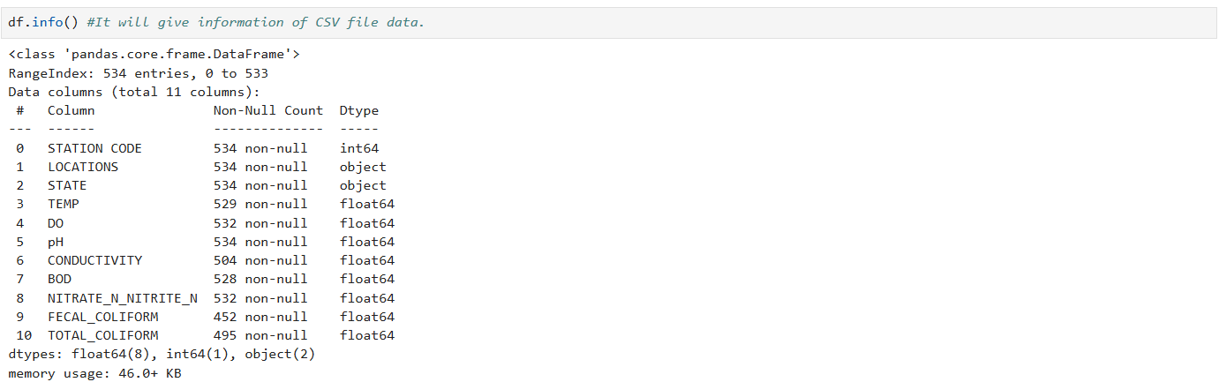
Handling Missing Values: Handling missing values effectively in marine and oceanic data involves choosing appropriate methods based on the nature of the data, the extent of missingness, and the analysis objectives. By employing imputation techniques, deletion methods, data augmentation, advanced statistical approaches, and sensitivity analysis, stakeholders can ensure that the data used to monitor and manage marine environments under SDG 14 is accurate and reliable.

Slide 10
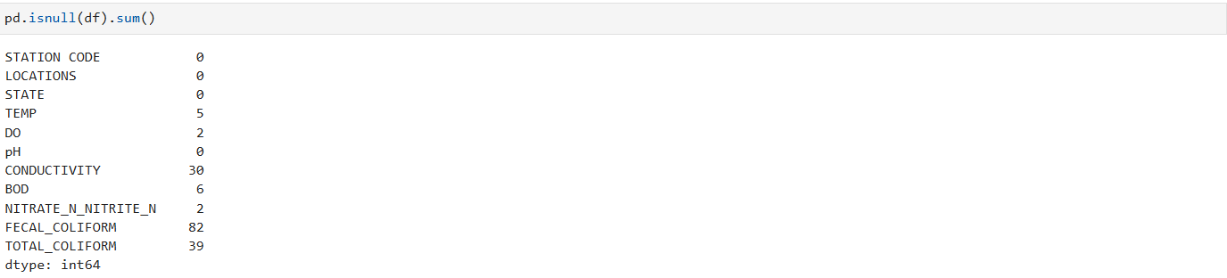
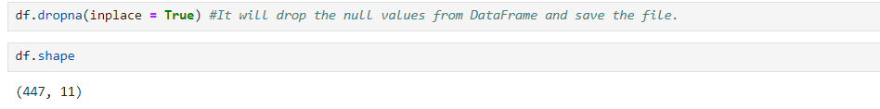
After finding the null values , using the dropna keyword all the null values from the CSV (Data frame) file are removed .

Slide 11
Conclusion
1.Reduce Marine Pollution
Outcome: Significant reduction in marine pollution, especially from land-based activities.
Indicator: Decrease in the amount of marine debris, particularly plastics, in the ocean.
2. Protect Marine and Coastal Ecosystems
Outcome: Enhanced resilience of marine and coastal ecosystems.
Indicator: Increase in the area of marine and coastal ecosystems that are protected and effectively managed.
3. Address Ocean Acidification
Outcome: Reduced rate of ocean acidification.
Indicator: Improved pH levels in ocean waters.
4.Protect Coastal and Marine Areas
Outcome: Expansion of marine protected areas (MPAs).
Indicator: Increase in the percentage of coastal and marine areas designated as MPAs.

Slide 12
Visualization
Key Visual Insights
Sustainable Practices: Infographics on sustainable fishing practices, pollution reduction methods, and marine conservation strategies offer practical solutions
Climate Change Impact : Visuals may include data on rising sea levels, ocean acidification, and their effects on marine life.
Marine Protected Areas: Maps and diagrams illustrating marine protected areas (MPAs) show regions where human activities are limited to help conserve marine environments.
Marine Life Diversity: Pictures of diverse marine species highlight the richness of ocean ecosystems.
Overfishing:Charts and infographics might depict the decline in fish stocks due to overfishing. Visuals often show the difference between healthy marine populations and those severely depleted by unsustainable fishing practices.

Slide 13
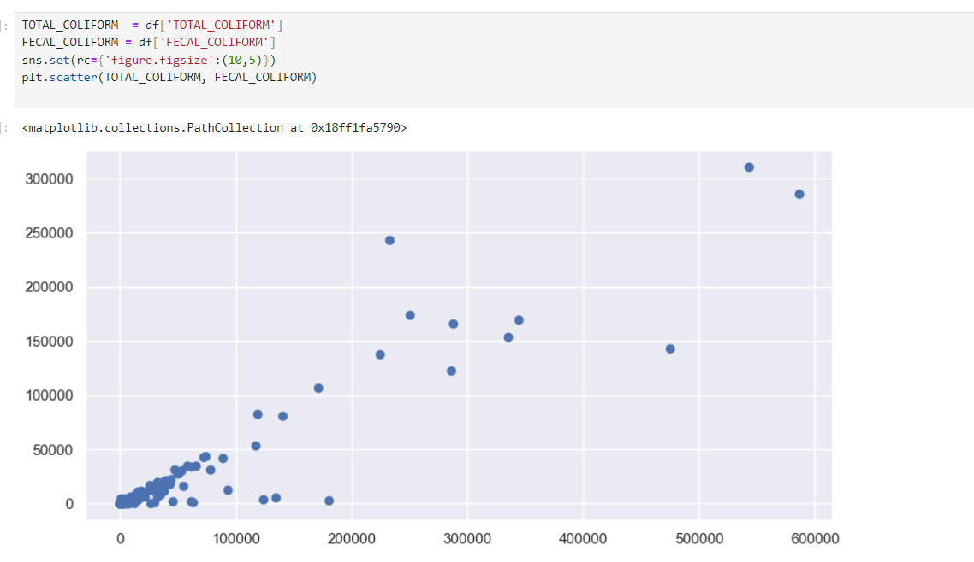
Scatter plot b/w total_coliform and fecal_coliform
Total coliforms include bacteria that are found in the soil, in water that has been influenced by surface water, and in human or animal waste.
Fecal coliforms are the group of the total coliforms that are considered to be present specifically in the gut and feces of warm-blooded animals.

Slide 14
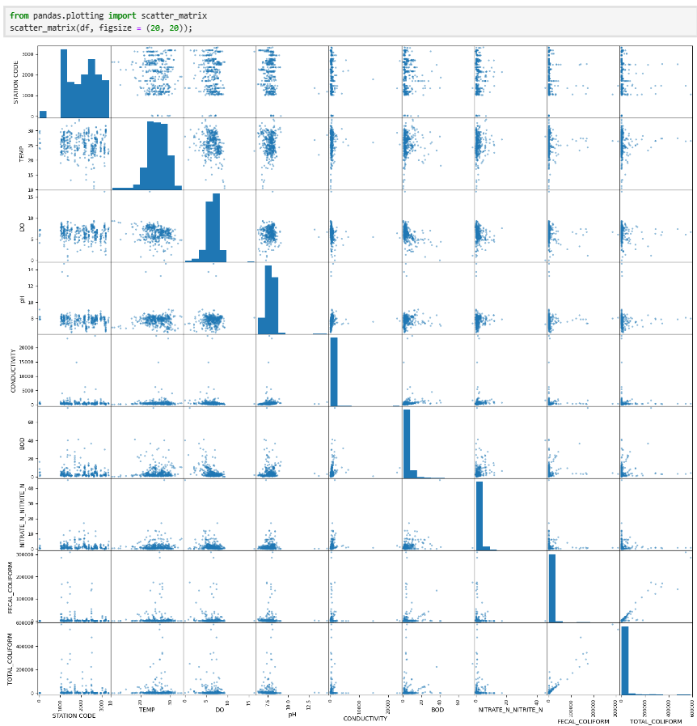
scatter plot
A scatter plot (aka scatter chart, scatter graph) uses dots to represent values for two different numeric variables. The position of each dot on the horizontal and vertical axis indicates values for an individual data point. Scatter plots are used to observe relationships between variables.

Slide 15
References
Data Sources
google : Kaggle , our world in data , UNESCO , UN Environment
Drive : Sample Verifide Projects
youtube : youtube.com
Tools and Software Used
Python
jupyter Notebook
Scikit learn
Additional References
Cai, J.N., Huang, H. & Leung, P.S. (2019)
Petterson, Michael G.; Kim, Hyeon-Ju; Gill, Joel C. (2021), Gill, Joel C.; Smith, Martin (eds.),

